Slide 1
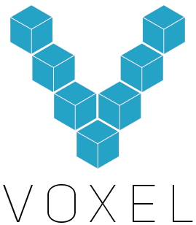

Slide 2
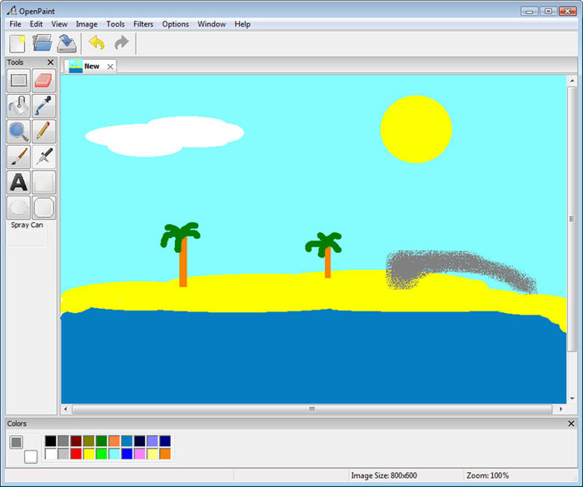
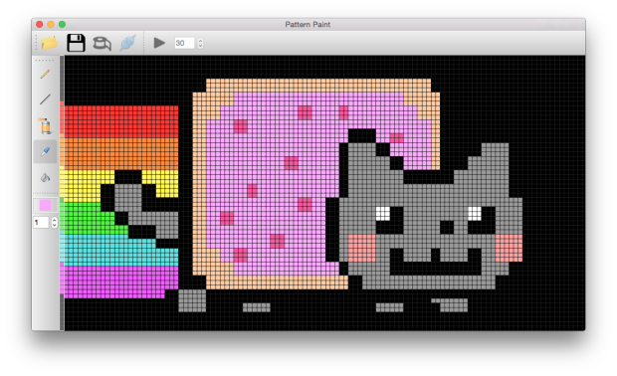
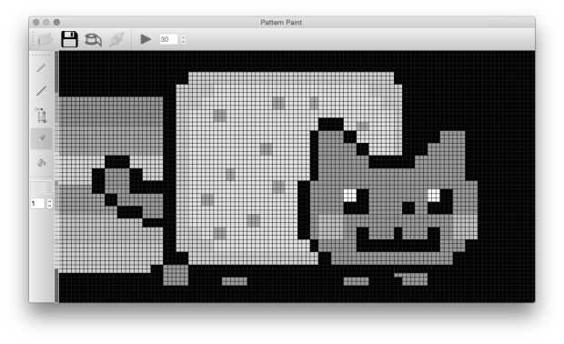
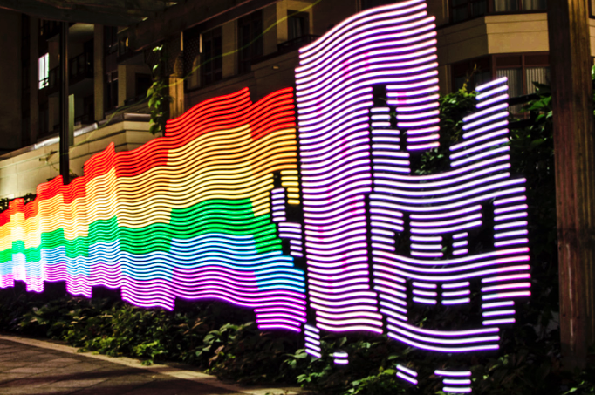
A Light Painting Magic Wand

Slide 3
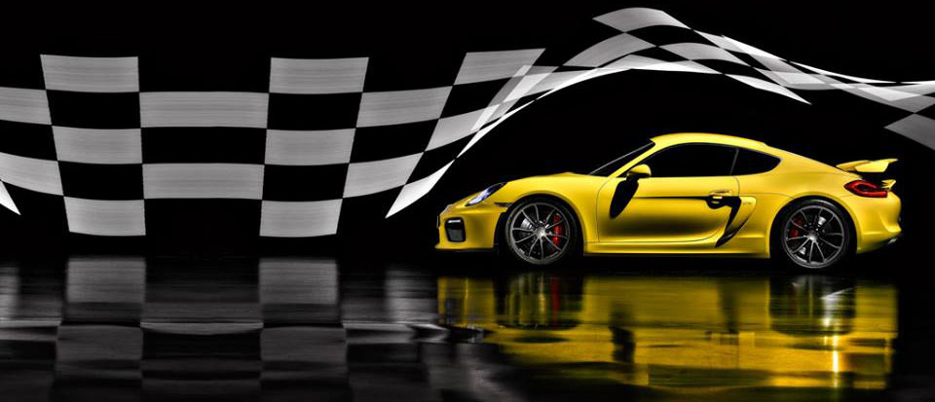
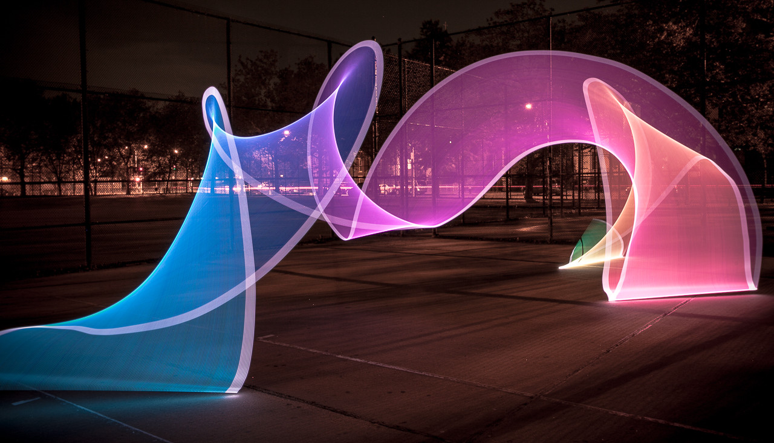
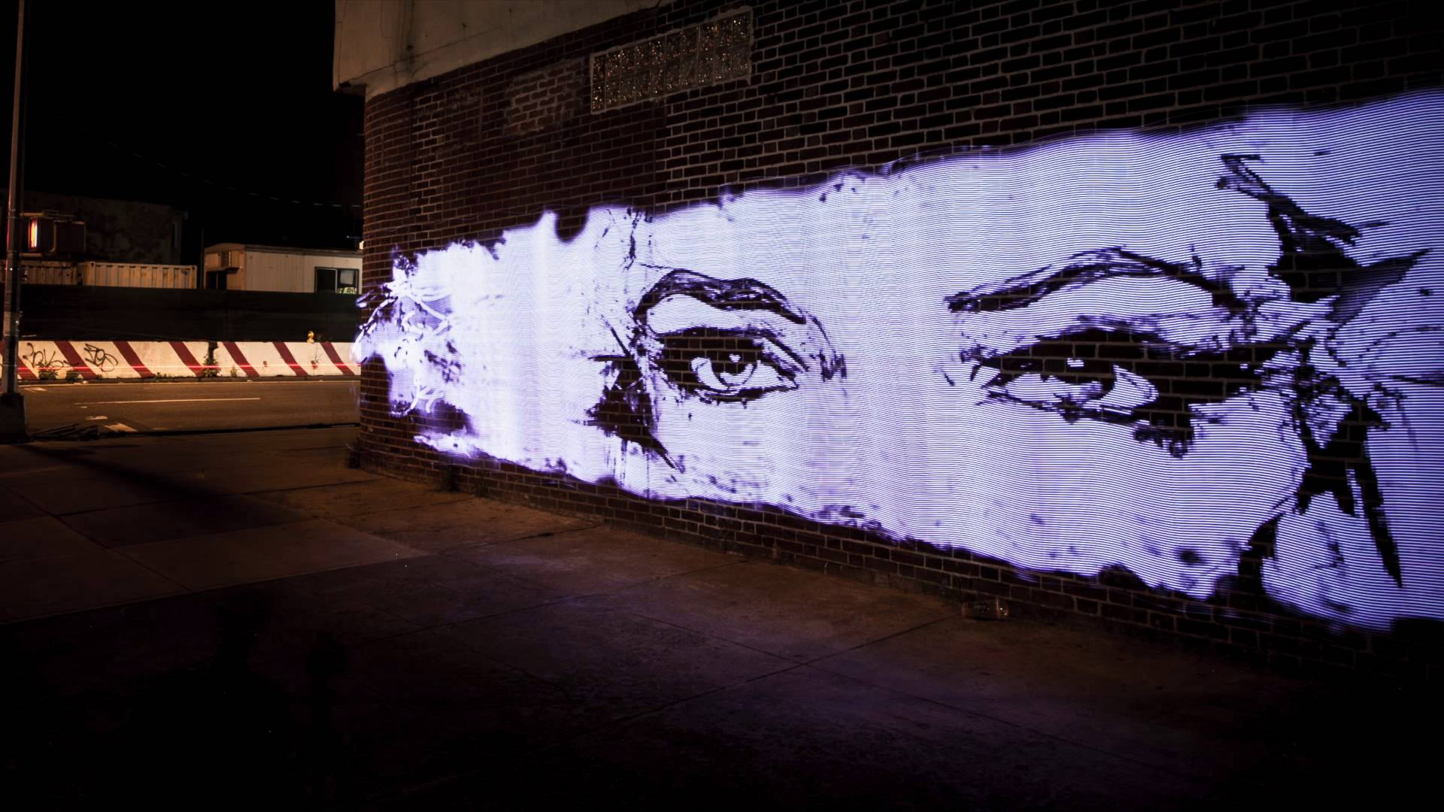
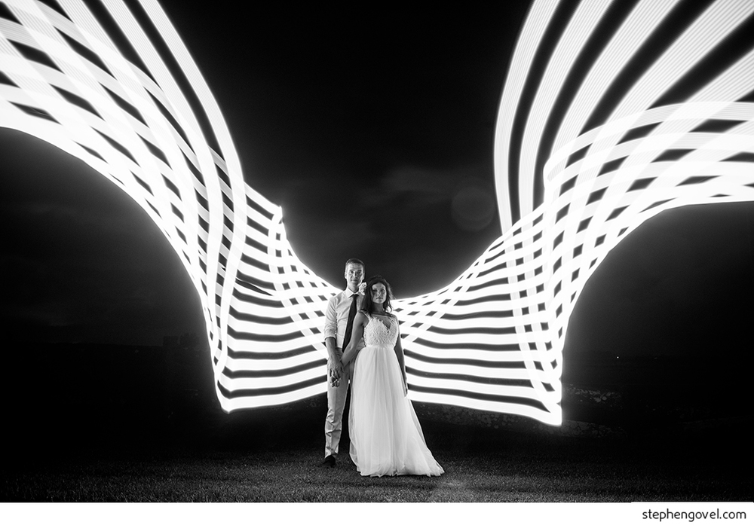
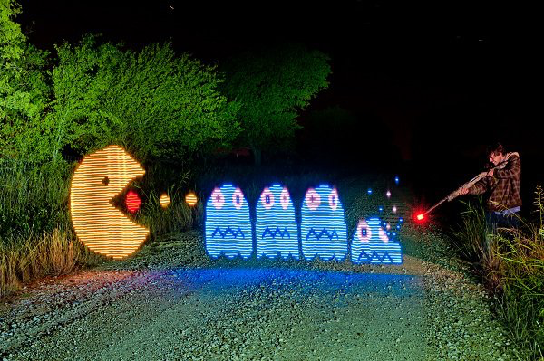
A New Dimension of Creativity

Slide 4
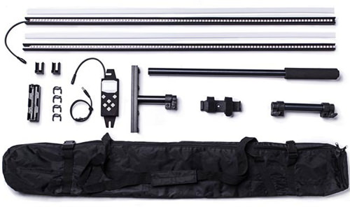
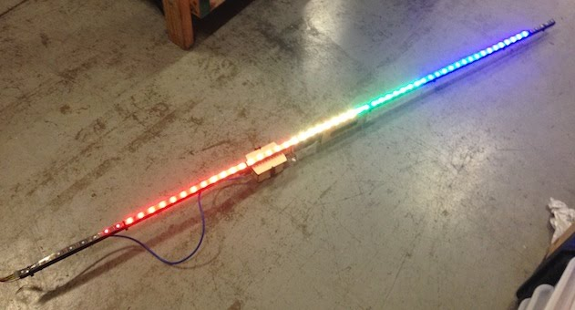
Existing Tools
DIY
PixelStick
Hours to Make or Setup
Pages of Documentation
Cumbersome User Interface

Slide 5
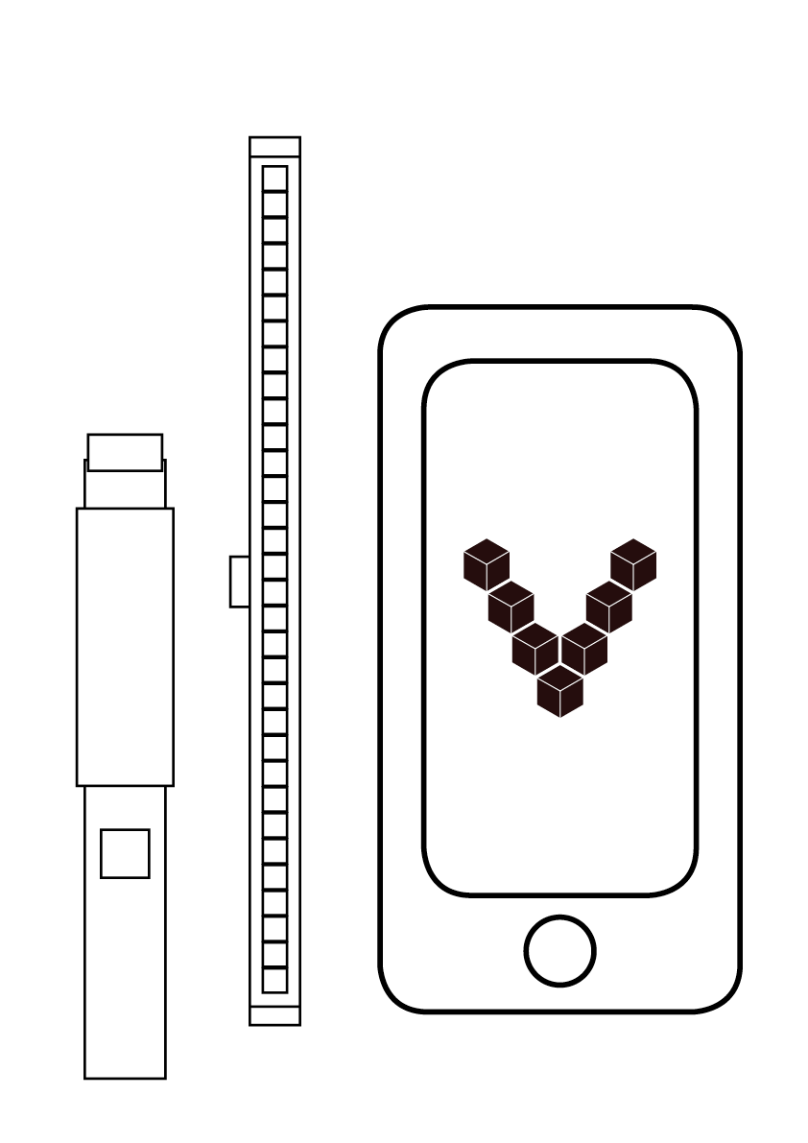
Handle
LED Modules
Mobile App

Slide 6
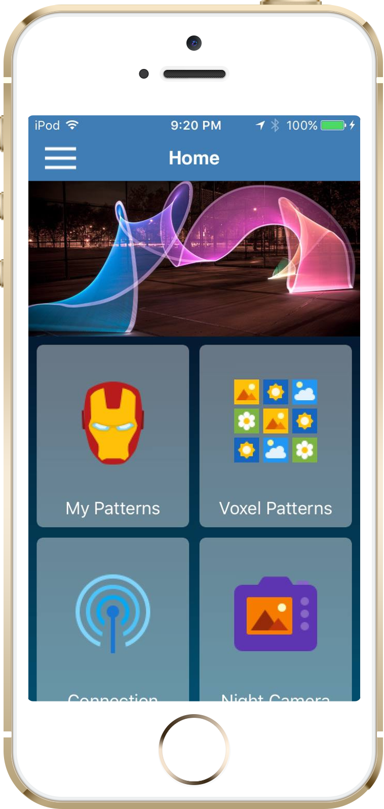




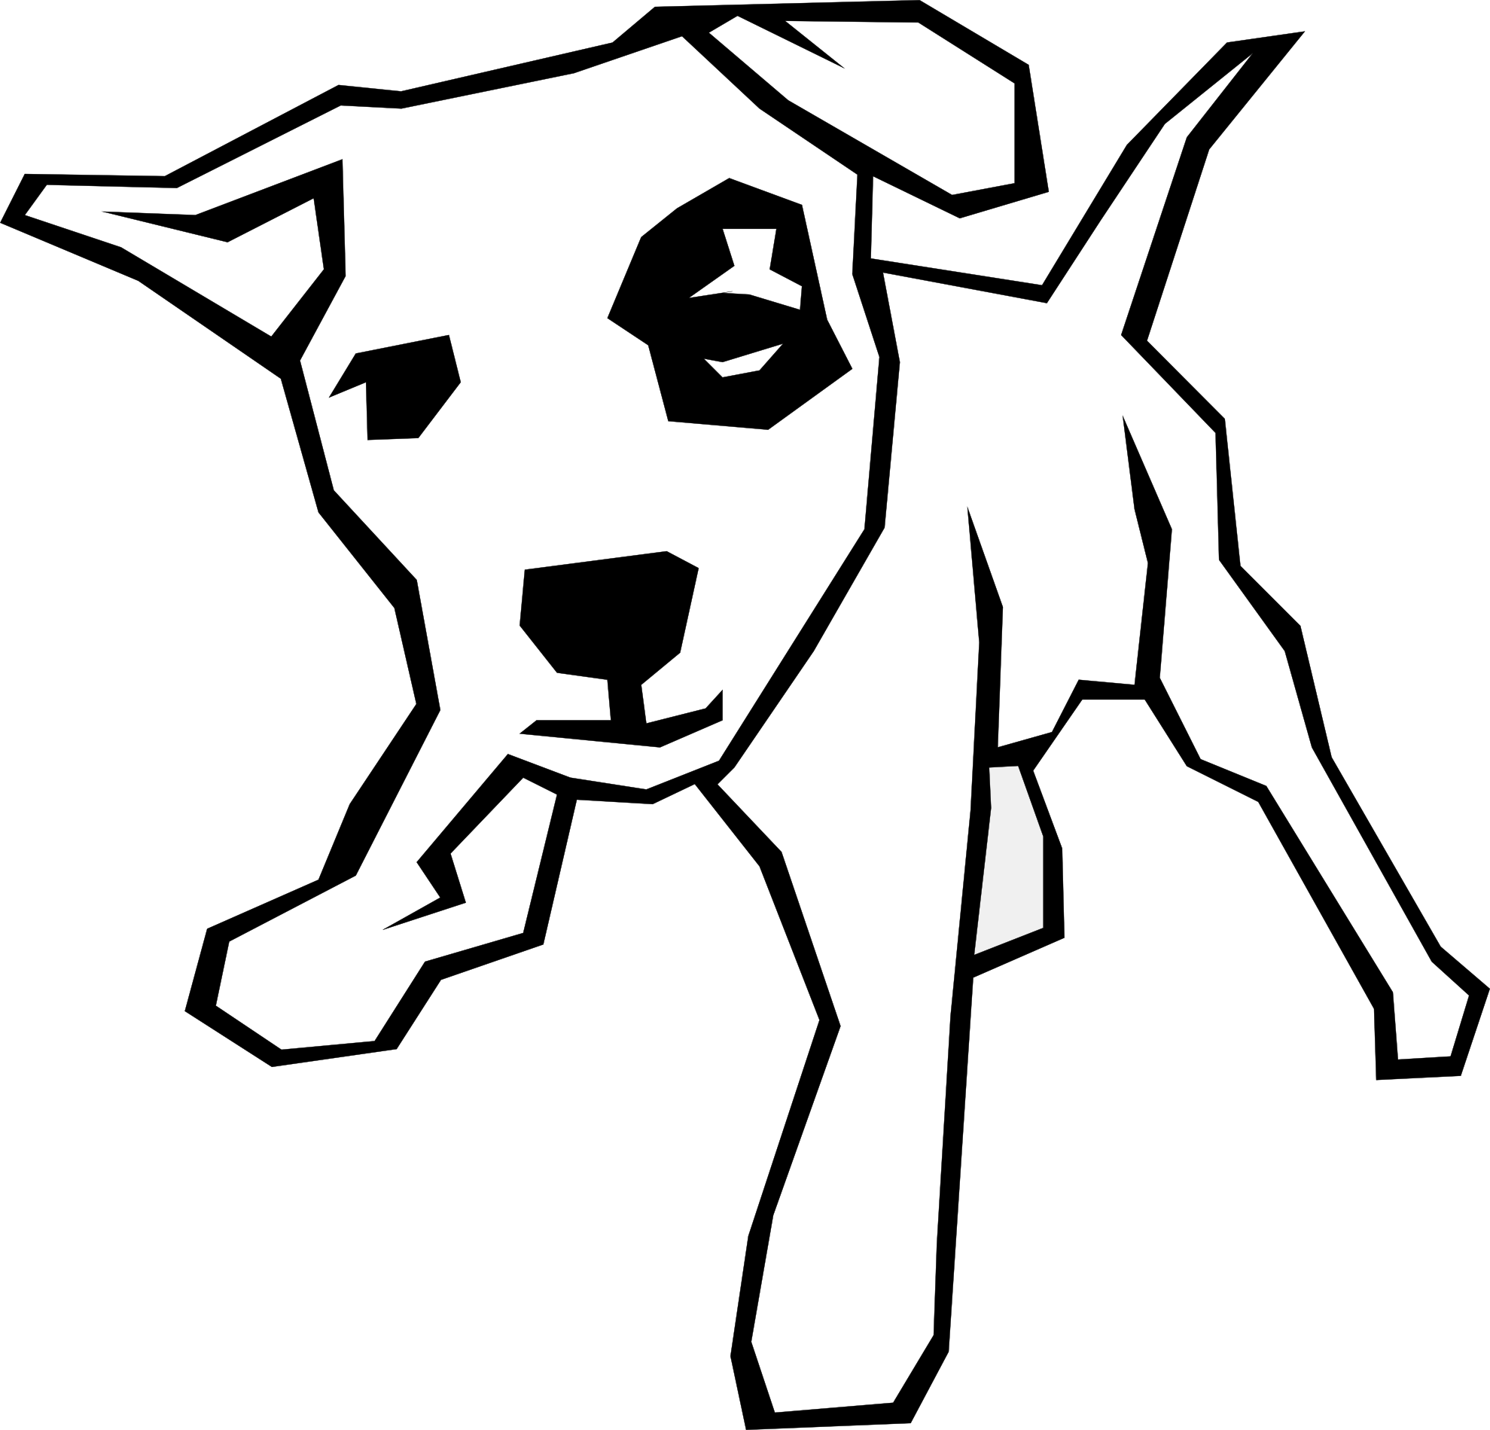

Powerful Mobile Software
(iOS 9.0)
Wifi connection
Quality
Designs
Auto image processing
In app image creation
Built-in
long exposure
camera

Slide 7
Modular Hardware
More Affordable
More Options

Slide 8
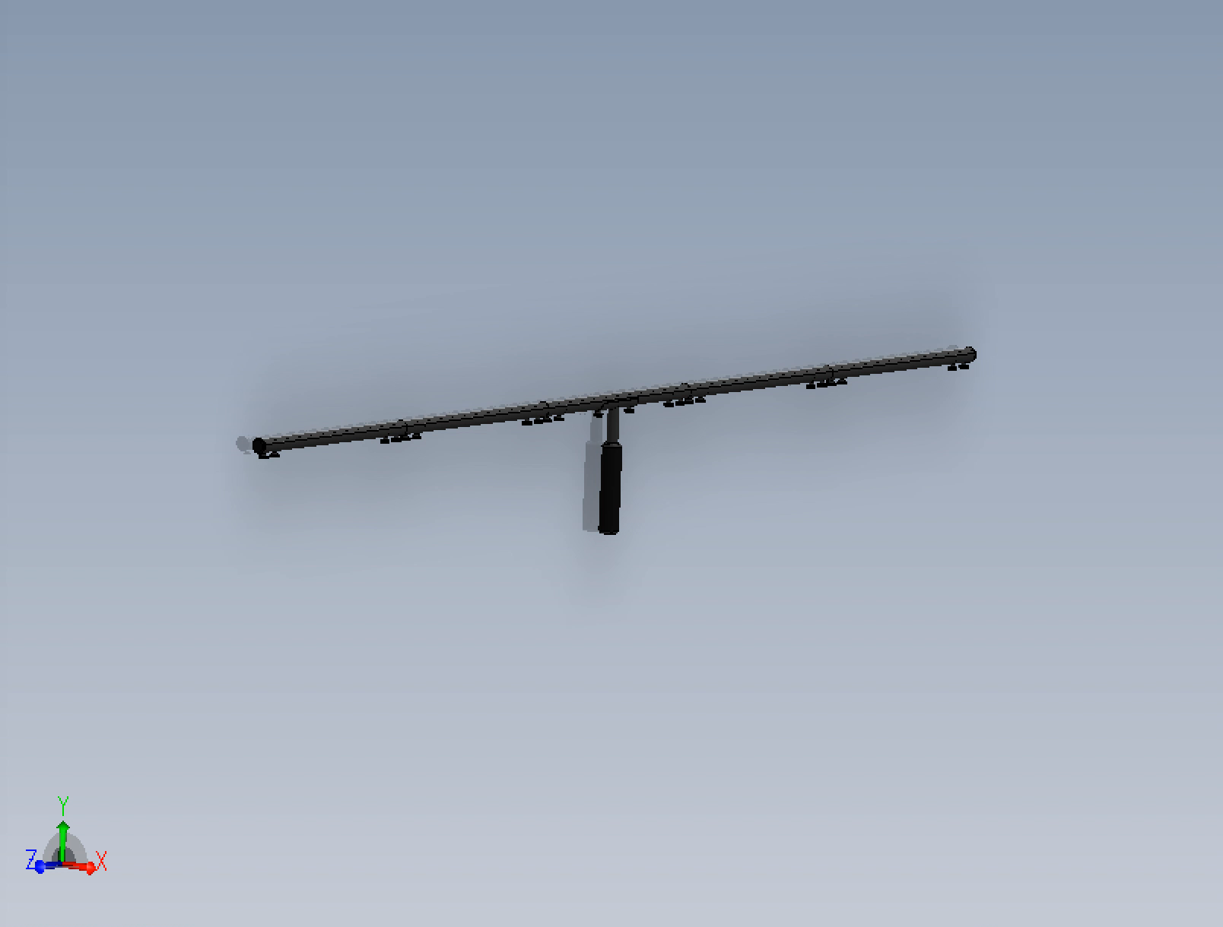
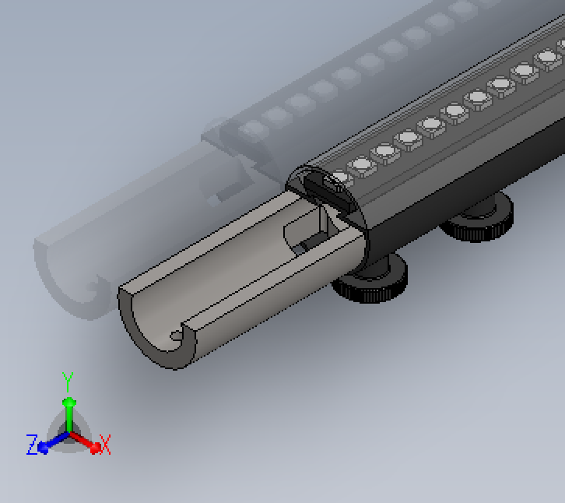
Ergonomic Industrial Design
(POC)

Slide 9
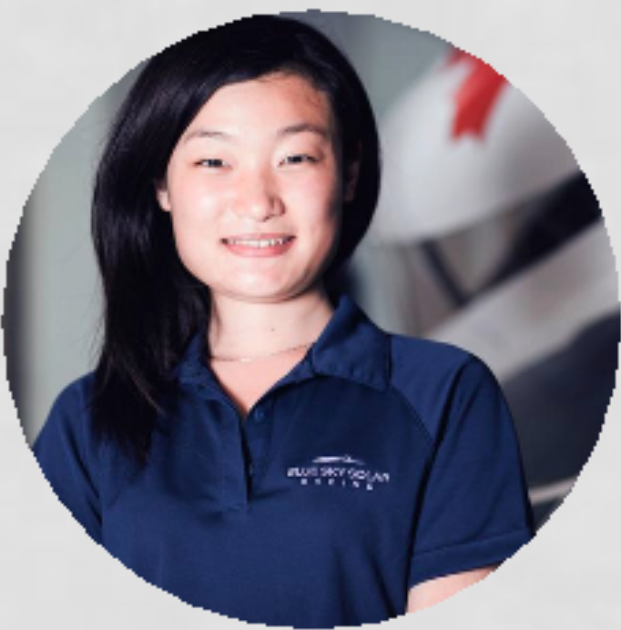



Team
Maria Xie
Lead Electrical
U of T EE 17
SciCan R&D
Blue Sky Solar EE Lead
Chaitanya Dogra Lead Mechanical
UW Tron 16
Structur3D Printing
Wescast Industries
Si Te Feng
Lead Software
UW Tron 17
Pebble
Clearpath Robotics
Tiange Li
Business Development
U of T Neuroscience 17
Toronto Rehab R&D

Slide 10
What’s the market?
All Camera Lighting
$910m*
*estimate based on extrapolation
of German statistics to world gdp
Phase 3
Sensors & accessories
50m
LED lighting
$80m
Phase 2
art & 3d model marketplace
20m
Phase 1
Simple light painting
9.5m
Notes:
Entire market extrapolated from Germany 2012 stats
Phase 1 size estimated using comparative size of r/photography vs. r/lightpainting.

Slide 11
Competitive Advantages
Customizable Hardware
Affordable
Automatic Image Processing
Simple Custom Artworks
Preloaded LED Patterns
Portable

